Slide 1


Determine the quality of a wine

Slide 2

Team Members :
MOGILI VISHAL GOUD
PRUTHVINATH REDDY S
VARADA SAKETA YASASVI
V.MANASA
R.PREETHI

Slide 3
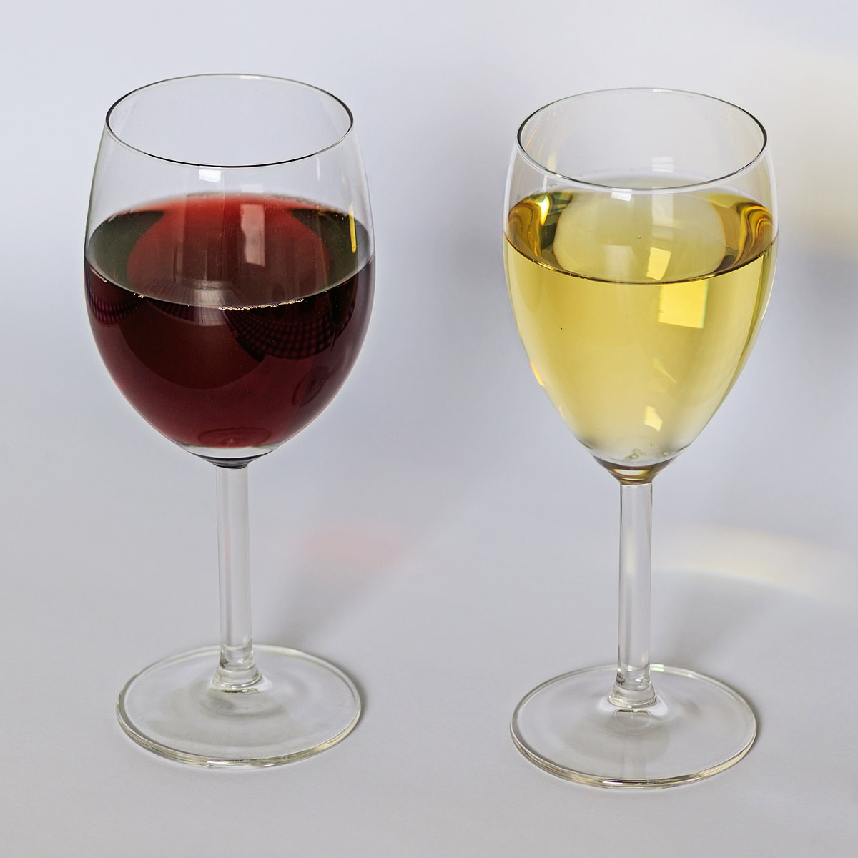

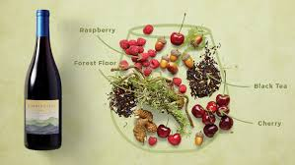
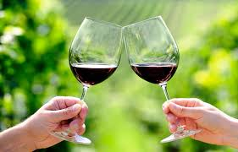
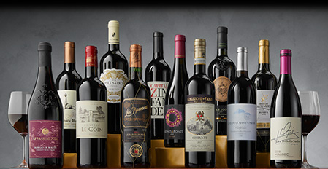
Vinho Verde
Vinho Verde were the first Portuguese wines exported to European markets.
In the sixteenth and seventeenth centuries the wines from the Minho Valley and the Lima Valley were regularly transported to northern Europe in the same boats that brought bacalhau (salt cod) and manufactured products.
By predicting the Quality of the wine we’ll be able to know the aroma, taste of the wine, whether it is complex or not, smooth or not

Slide 4
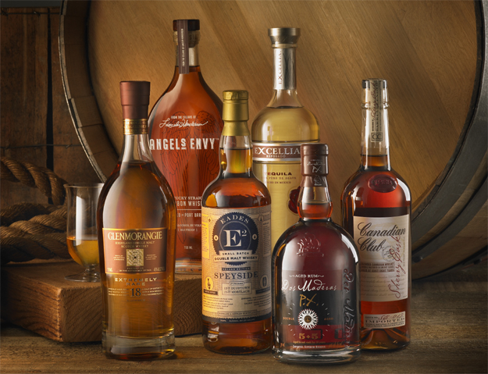
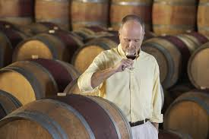
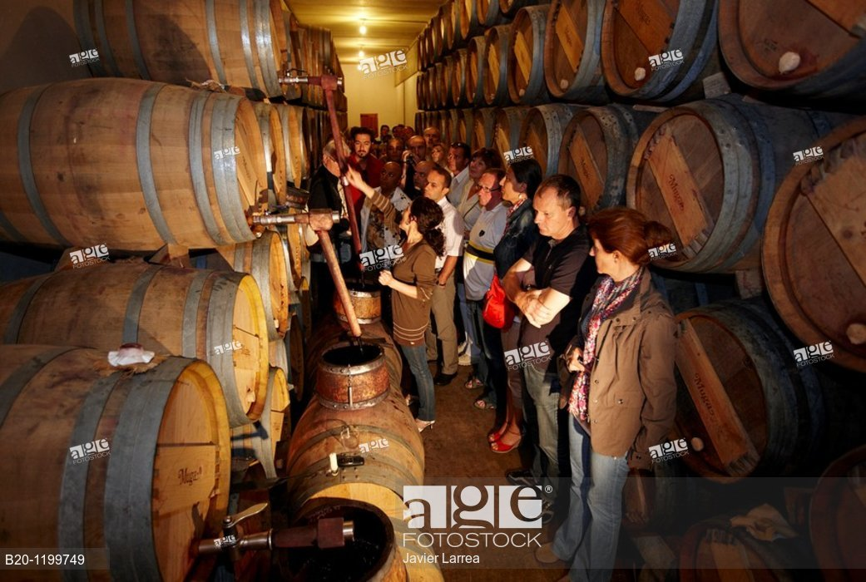
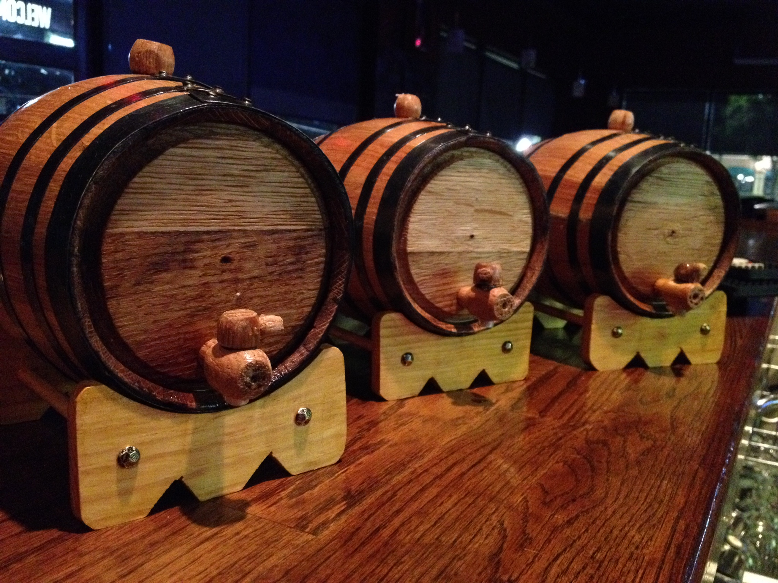
Cask Aging:
Vinho Verde Wine has various categories of aging:
Old Reserve: at least 2 years of cask aging.
Very Old: at least 3 years of cask aging
VSOP (Very Superior Old Pale): at least 4 years of cask aging
XO (Extra Old): at least 6 years of cask aging

Slide 5

What we did in this project ?
We have used artificial neural network classification for this model
We have collected a dataset containing records of the attributes like pH, density etc.
We were able to train the model to get an accuracy of 97% by using gradient boosting classifier with optimized hyperparameters
We were able to create an application which would predict the quality of the wine, which will help us to know the aroma, taste, color, whether it is complex or not, smooth or not
The application is also able to take input values and predict the quality

Slide 6
Procedure and code :
We split the dataset into training set and testing set
We the imported Sequential and and Dense from keras.models and keras.layers to add input , hidden and output layers.
We have used the activation function softmax and in the compiler we used categorical_crossentropy for loss funtion(as we are dealing with categorical values)
We have used the optimization algorithm adam instead of the classical stochastic gradient descent procedure to update network weights iterative based in training data.
Next we trained the model with epochs value as 100
After that we stored the predictive model in y_pred

Slide 7
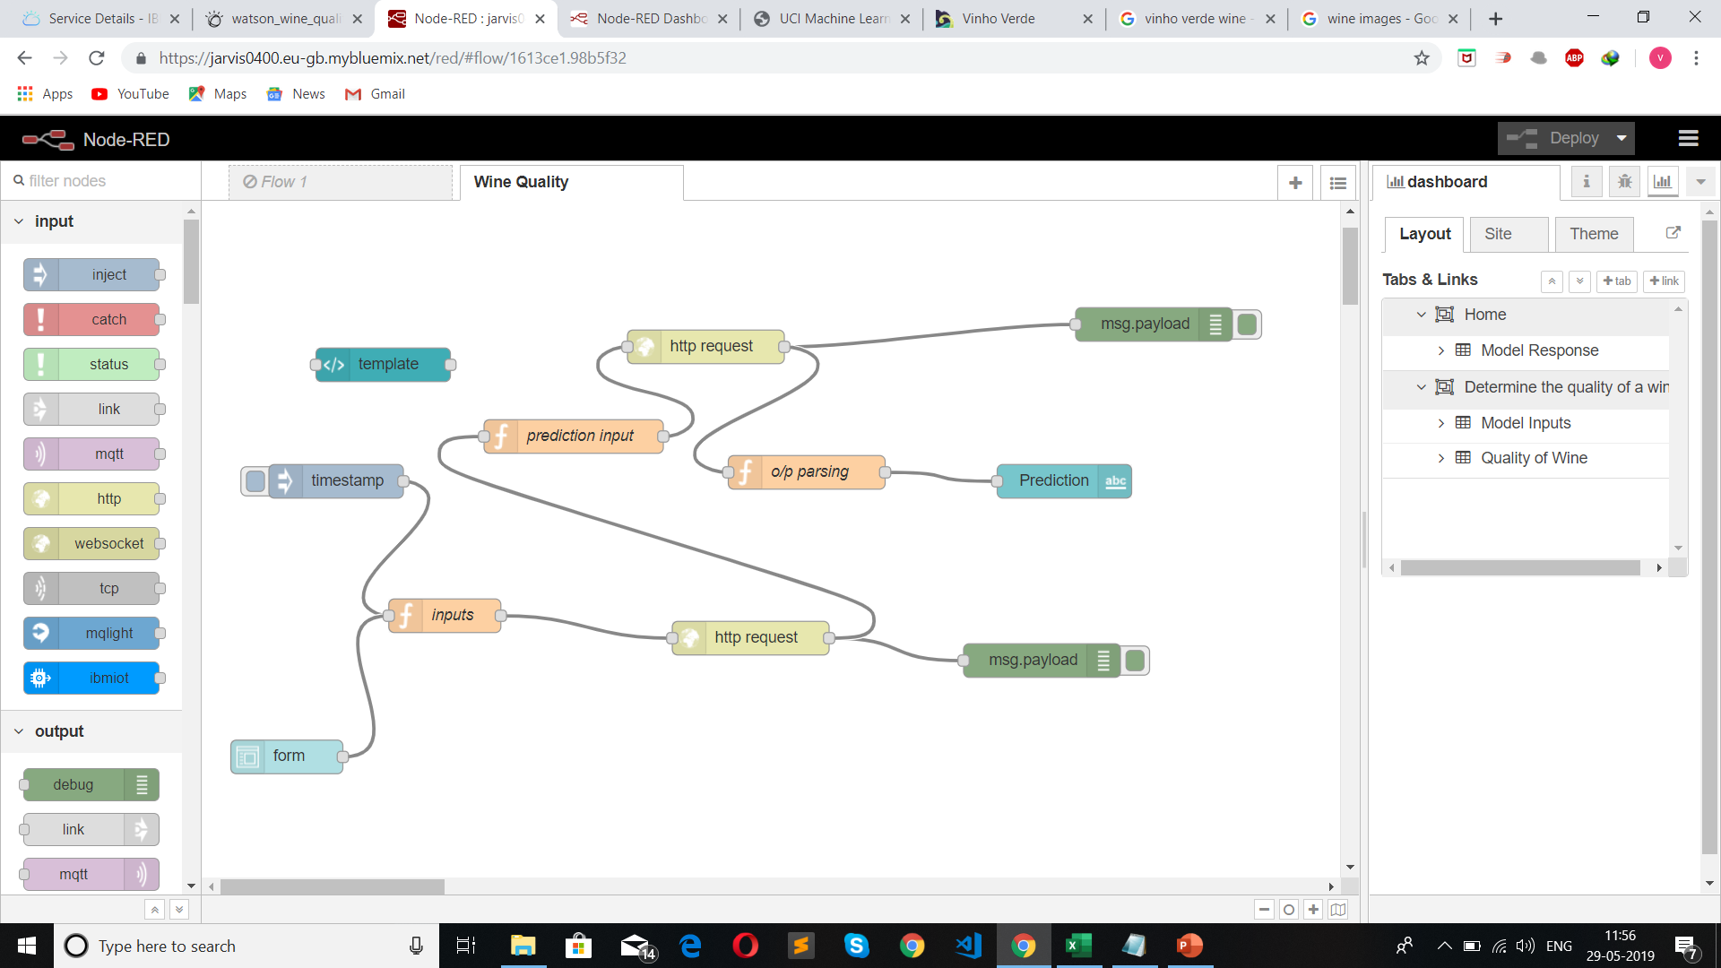
Node-RED flowchart

Slide 8
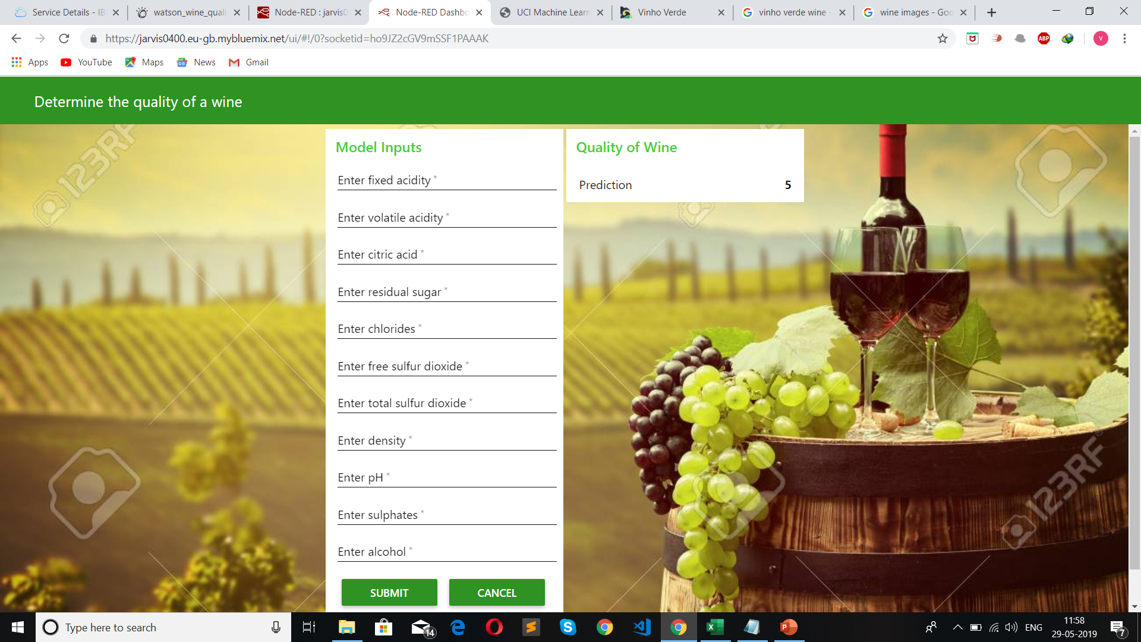
Quality predictor application
Here we need to give the input values so that the quality of wine is predicted.

Slide 9
THANK YOU

